Slide 1
Crafting Catchy Computer Art with Python Turtle
Doug Purcell

Slide 2
I’m Doug Purcell
A software engineer
5X published author
A creative entrepreneur
Working to create an online coding school

Slide 3
Why This Talk Can Unveil A New World of Possibilities!
Perfect for educators that want to find a way for students to stay motivated in programming.
Suitable for artists, designers, or creative folks that want to learn programming but can’t find the motivation to stick with it.
Excellent for those who are completely new to programming and are having trouble mastering the fundamentals such as data types, data structures, iteration, and forming solutions.
Suitable for new developers that want to learn algorithmic programming.
Great for beginners that want to code something that they can showcase.

Slide 4
Don’t’ Worry If You Don’t Understand Everything

Slide 5
First thing first, we need python installed!
Visit www.python.org/downloads and follow the steps for your machine.
I’ve put together some quick instructions on my blog: http://purcellconsult.com/python-installation-tutorial

Slide 6
For Those in a Rush
Access online python interpreter with turtle installed here: https://repl.it/languages/python_turtle

Slide 7


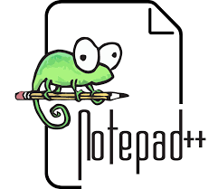


What Should I Write My Python Code In?

Slide 8
I recommend PyCharm Community Edition for Beginners
Free download
Comes with features that speeds up coding such as autocomplete and introspection.
Comes bundled with a clean and easy to use debugger
A nice balance of features
Has a large community of supporters which ensures longevity
Download PyCharm: https://www.jetbrains.com/pycharm/download

Slide 9
You’re Free to Use Whatever IDE or Editor You Want

Slide 10
At This Point Everyone Should Have Their Environment Setup
Should have python installed and an IDE, or at least using the oinline python interpreter.

Slide 11
Run a Simple Test
If you’re on Windows open up the command line by typing cmd in the search bar. If you’re on Apple or Linux open the terminal. Type python and then type in the following statement:
Print(‘Hello World!’)

Slide 12
The text ‘Hello World!’ should be displayed to the console
Anyone need help getting this to work?

Slide 13
Ok, Let’s Go Over Some Basics in Python
Let’s do some live coding on the python interpreter and Ipython. Let’s take a trip that memory lane and do some basic math with python.

Slide 14
Let’s Build some simple programs based on what we know
Fahrenheit to Celsius Converter: (32°F − 32) × 5/9
Miles to km converter: 1 mile = 1.60934 km
1 American = 1.33 Canadian dollars.

Slide 15
The input() function Demo

Slide 16
Write a simple ice breaker program using input()
Ask the user for their name.
Ask them for their occupation.
Ask them for their favorite food.
Separate the output with commas. This is one way to format this data type in python.

Slide 17
How Would You Create a Simple Text Based Calculator?
get_number = int(input(‘Enter in a number ‘))

Slide 18
Keep Things Simple
Read in two numbers and then add, subtract,divide, and multiple them

Slide 19
More mathematical functions
Have to import the math module to use all of them.

Slide 20
Moving Along…

Slide 21
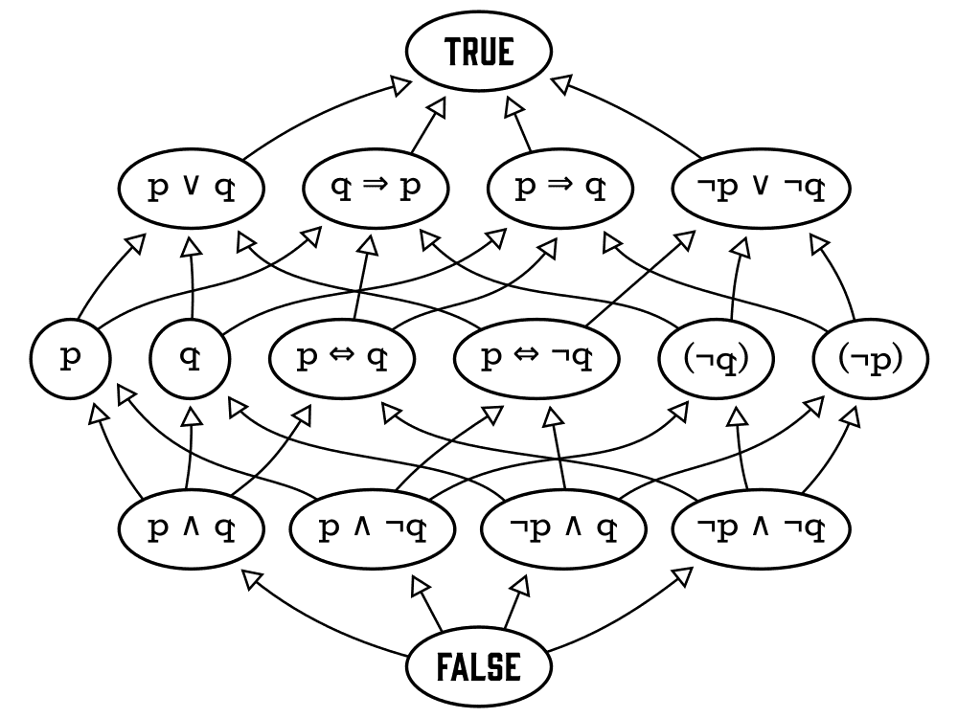
Boolean Algebra

Slide 22
If/else statement python
x = 5
if x > 10:
print('hi')
else:
print('catch you later')

Slide 23
Use elif to chain multiple conditional checks
y = 10
if y > 10:
print('bigger')
elif y < 10:
print*'smaller')
else:
print('equal')

Slide 24
for and while loops. Allows repetitive statements.
for x in range(10):
print(x)
Prints 0 … 9 on new lines

Slide 25
While loop
Another type of loop:
i = 0
while I < 10:
print(i)
i += 1

Slide 26
Loops can be nested. One inside another
for x in range(3):
for y in range(3):
print(y, end=‘ ‘)
print()
Prints a grid of numbers:
0 1 2
0 1 2
0 1 2

Slide 27
Functions
A set of input maps to a set of output.

Slide 28
Simple Function Example
def f(x):
return x * x
>>> f(10)
…
100

Slide 30
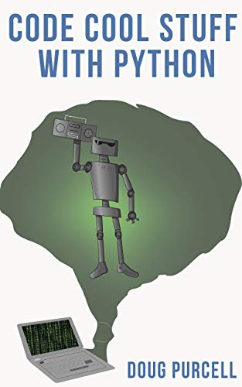
There’s a lot more to that
And we’re pressed for time. A shameless plug to checkout my book “Code Cool Stuff With Python” on Amazon for a more comprehensive overview of python: https://www.amazon.com/Code-Cool-Stuff-Python-Purcell-ebook/dp\\/B081XJMNRB

Slide 31
Enter the following code and run the program
import turtle
leonardo = turtle.Turtle()
leonardo.shape('turtle')
leonardo.shapesize(7.5, 7.5)
leonardo.color('green')
turtle.done()

Slide 32
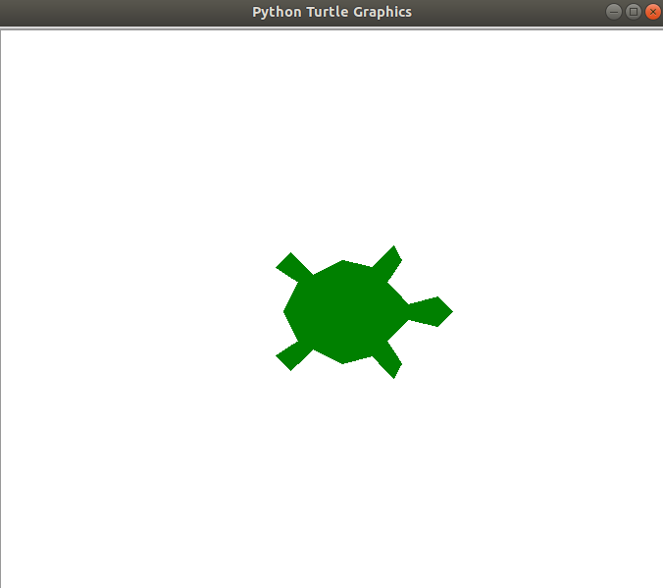
Let’s Program This Image

Slide 33
Line One
>>> import turtle
Imports the turtle module so that we can use all of the builtin functionality.

Slide 34
Line Two
>>> leonardo = turtle.Turtle()
Once the module is imported we can go ahead and call the Turtle constructor.

Slide 35
Line Three
>>> leonardo.shape('turtle')
We can change the default shape of the turtle object to something more appealing like a green turtle using shape.

Slide 36
Line Four
>>> leonardo.shapesize(7.5, 7.5)
Stretches the turtle shape. The first parameter corresponds to the width while the second one corresponds to the length.

Slide 37
Line Five
>>> leonardo.color('green')
Sets the color of the turtle to green.

Slide 38
Line Six
>>> turtle.done()
Starts the event loop which in essence calls Tkinter’s main loop function.

Slide 39
Want to Explore all of the Cool Functionality of Turtle?
https://docs.python.org/3.3/library/turtle.html?highlight=turtle

Slide 40
How Would You Define a Square?

Slide 41
A Square Has...
Four sides of equal length
Four right angles
How can we use this definition to code a square in turtle?

Slide 42
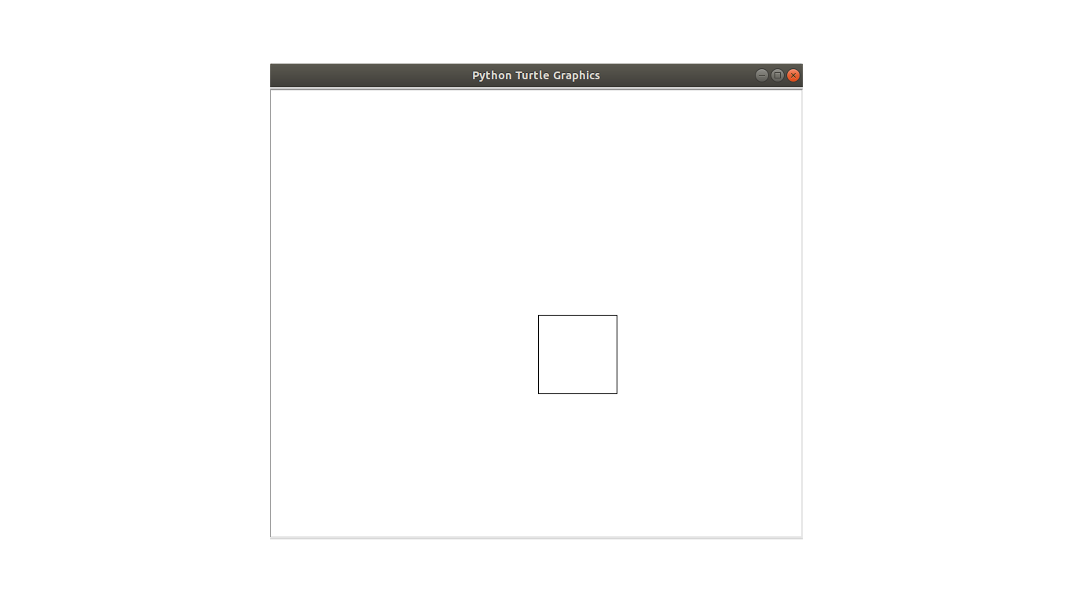
A Simple Square Image in Python

Slide 43
Here’s The Code
import turtle
square = turtle.Turtle()
square.hideturtle()
square.forward(100)
square.right(90)
square.forward(100)
square.right(90)
square.forward(100)
square.right(90)
square.forward(100)
turtle.done()

Slide 44
A lot of Repeated Statements in The Code
4 calls to forward and 3 calls to right

Slide 45
Shorten The Code With a for Loop
import turtle
square = turtle.Turtle()
square.hideturtle()
for x in range(4):
square.forward(100)
square.right(90)
turtle.done()

Slide 46
Adding Colors to Turtle Graphics
Just like how film would be humdrum with traditional black-and-white television, the same concept applies to your turtle computer graphics.
We can spice things up by adding color to our images. Turtle enables pythonistas the ability to do this via the color function.
You can read about it in the turtle module here: https://docs.python.org/3.3/library/turtle.html?highlight=turtle#turtle.color
You can call it with no arguments, one argument, or two arguments. When you pass in one argument it returns the pencolor and current fillcolor as a pair; it doesn't actually manipulate the color, just returns what color is in the turtle object.

Slide 47
This is Great, But...
Sometimes when you’re creating images you’re not exactly sure what colors to use… Ta-da, this is where the PyRandomColor comes to the rescue.

Slide 48
The PyRandomColor Open source Module
An open source module that I created under the GPL license that allows pythonistas to randomly add colors to their turtle graphics.
There’s two simple ways to download PyRandomColor:
$ pip install pyrandomcolor
$ git clone https://github.com/purcellconsult/PyRandomColor.git

Slide 49
A list of functions from PyRandomColor
get_random_color(): Picks any random color.
whites_and_pastels(): Returns a random color that’s within the white and pastel color scheme.
grays(): Returns a random color that’s within the gray color scheme.
blues(): Returns a random color within the blue color scheme.
greens(): Returns a random color within the green color scheme.
yellows(): Returns a random color within the yellow color scheme.
browns(): Returns a random color within the brown color scheme.
oranges(): Returns a random color within the orange color scheme.
pinks_violets(): Returns a random color within the pinkish and violetish color scheme.

Slide 50
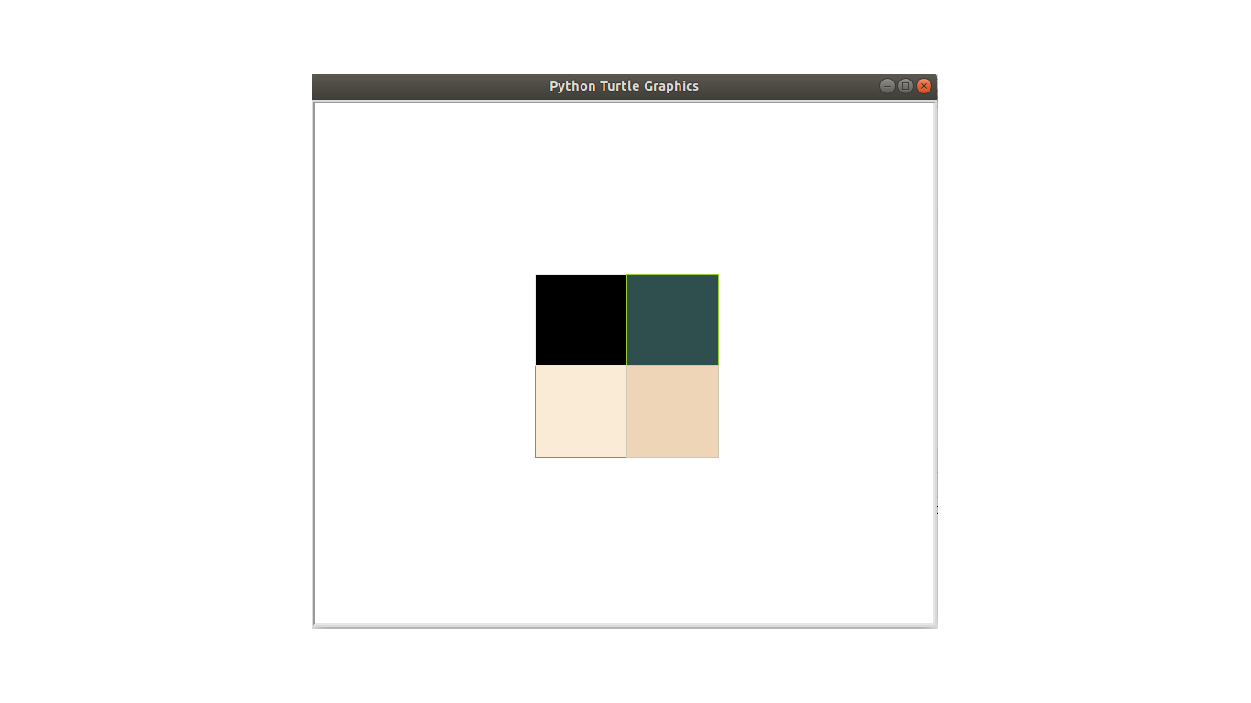
Let’s Create a Square Portrait Like The Below

Slide 51
Let’s See This in Action
$ python multi_color_cube.py

Slide 52
import turtle
from random_colors import get_random_color
square = turtle.Turtle()
square.hideturtle()
for x in range(4):
square.color(get_random_color(), get_random_color())
square.begin_fill()
square.right(90)
for y in range(4):
square.forward(100)
square.right(90)
square.end_fill()
turtle.done()

Slide 53
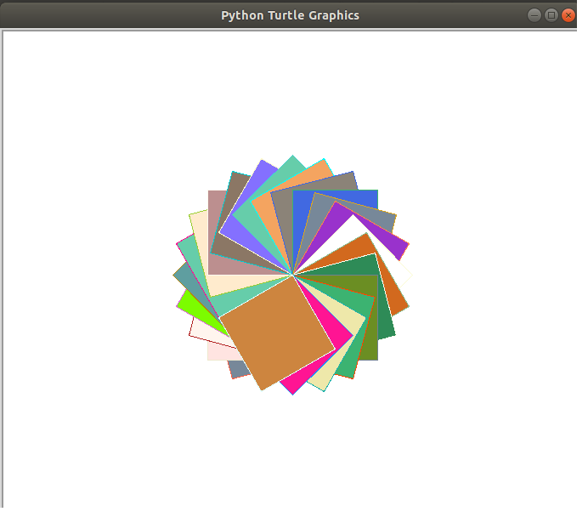
More Square Artwork

Slide 54
import turtle
from random_colors import get_random_color
square = turtle.Turtle()
square.hideturtle()
square.speed(0)
for x in range(50):
square.color(get_random_color(), get_random_color())
square.begin_fill()
square.right(35)
for y in range(4):
square.forward(100)
square.right(90)
square.end_fill()
turtle.done()

Slide 55
Let’s Move On to Another Shape
How about a circle?

Slide 56
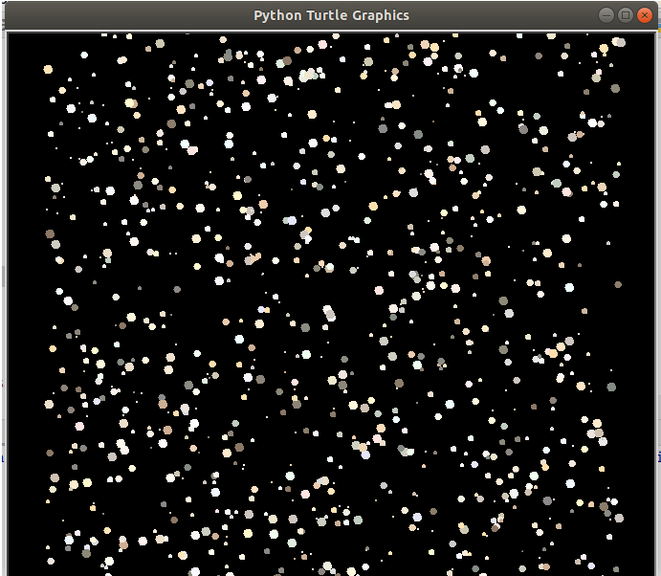
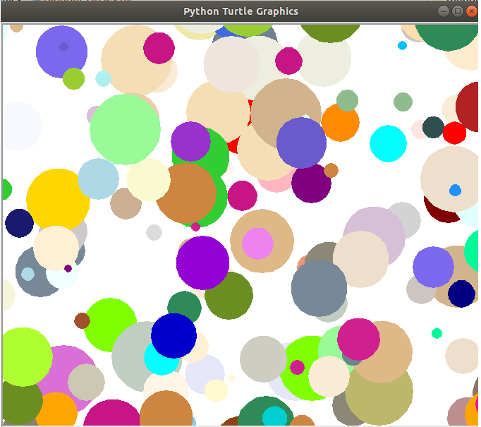
We’ll Create Cool Artwork Like The Following
Notes:
What does the image on the left look lilke?

Slide 57
How to Create a Circle in Python Turtle
turtle.circle(radius, extent=None, steps=None)

Slide 58
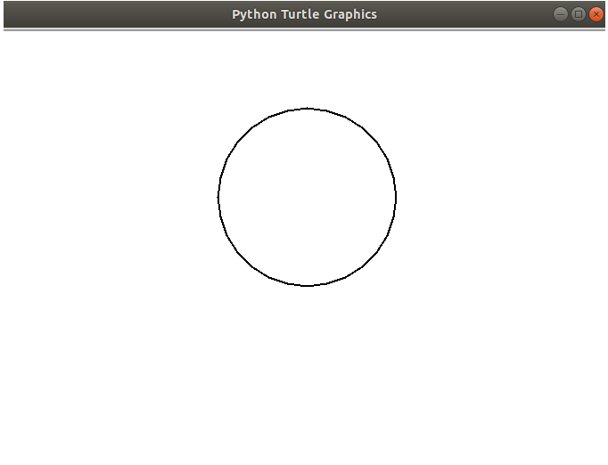
How to Create a Simple Square in Turtle?

Slide 59
Code
import turtle
x = turtle.Turtle()
x.hideturtle()
x.pensize(2)
x.circle(100)
turtle.done()

Slide 60
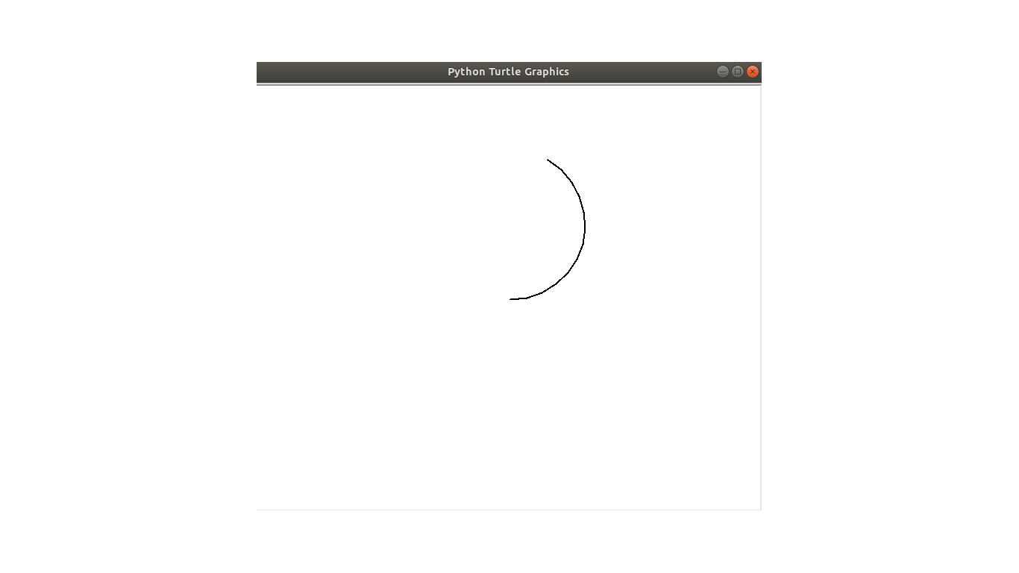
To Create an Arc

Slide 61
Do The Following
import turtle
x = turtle.Turtle()
x.hideturtle()
x.pensize(2)
x.circle(100, extent=150)
turtle.done()

Slide 62
Ok, So How Do We Code A Randomly Generated Night Sky?

Slide 63
Demo of the Night Sky
$ python night.py

Slide 64
Our Checklist
What we know thus far:
How to create circles
How to randomly color objects
What we don’t know:
How to change the background color of the screen
How to randomly position various circles on the screen

Slide 65
How to change the background color?
>>> turtle.Screen().bgcolor('black')

Slide 66
How to randomly position circles on the screen?
There are three methods in turtle that can help out with this:
· penup: Picks the pen up, no drawing happens.
· pendown: Puts the pen down.
· goto(x, y=None): Move the turtle to the x and y coordinates.

Slide 67

Imagine That You’re Drawing

Slide 68
What happens when...
You’re chilling at your desk drawing a masterpiece on a blank piece of paper. What would happen if you decide to pick your pen up and move it to a different position on that same paper? The pen will now appear at the new spot. When you put the tip of your pen back down this is when the drawing happens.

Slide 69
Similar logic in Turtle
The penup and pendown methods operate in a similar fashion to how you draw on a piece of paper. When the penup function is called the pen is in the air, and when the pendown function is called that is like placing the tip of your pen on the paper to start drawing. These two functions are important because when you use the goto function, if you don’t call the penup function then nasty squiggly lines will be drawn along the way, like if you’re sketching a stickman on a piece of paper.

Slide 70
Night Sky Solution
def create_night_sky(stars=1000):
sky = turtle.Turtle()
back_ground = turtle.Screen()
back_ground.bgcolor('black')
num = stars
sky.speed(0)
for x in range(num):
sky.color(whites_and_pastels())
sky.begin_fill()
sky.penup()
sky.goto(randint(-300, 300), randint(-300, 300))
sky.circle(randint(1, 5))
sky.pendown()
sky.end_fill()
turtle.done()

Slide 71
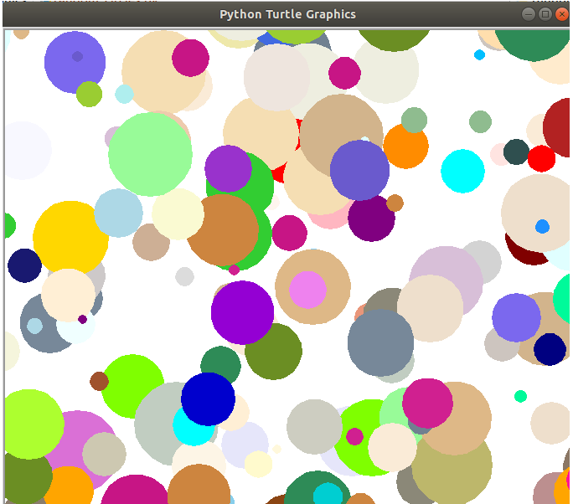
More Circle Art

Slide 72
Demo the Circle Ar
$ python random_circles.py

Slide 73
Source Code here: https://github.com/purcellconsult/Code-Cool-Stuff-With-Python/blob/master/sourcecode/ch_04/random_circles.py

Slide 74
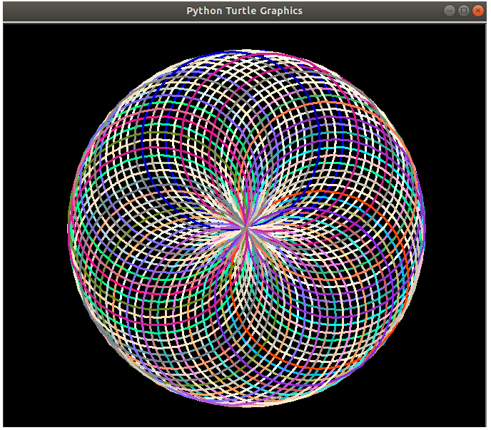
Let’s Create a Spirograph

Slide 75
Show Demo
$ python spirograph_1.py

Slide 76
The Solution
import turtle
from random_colors import get_random_color
def create_circles(cycles=100):
turtle.bgcolor('black')
turtle.pensize(3)
turtle.speed(0)
for i in range(cycles):
turtle.color(get_random_color())
turtle.circle(125)
turtle.right(25)
turtle.done()

Slide 77
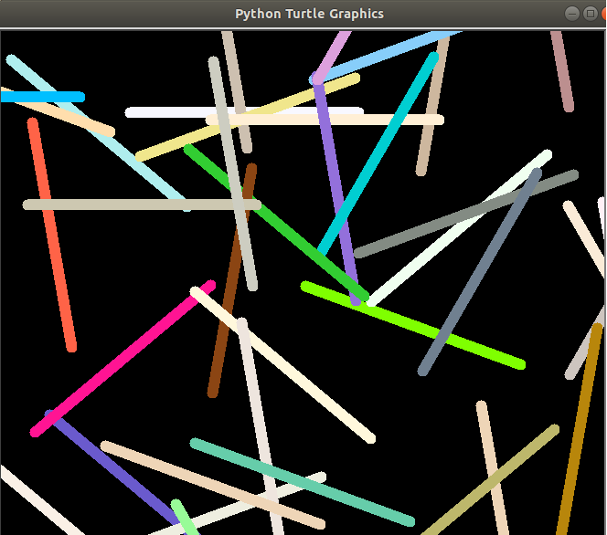
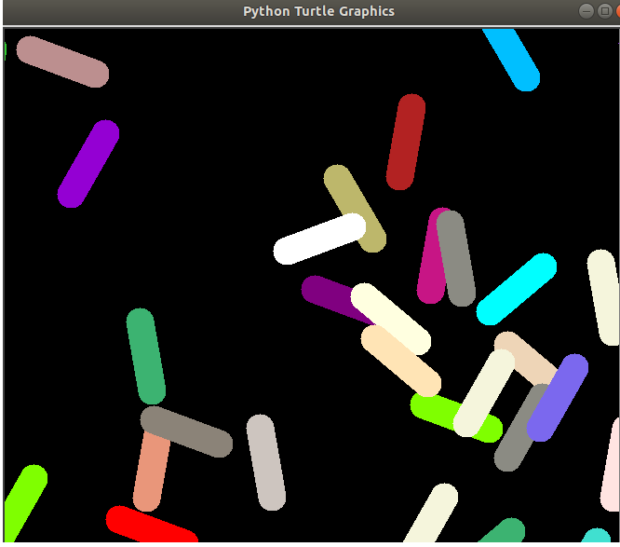
Creating Artwork With Lines in Turtle

Slide 78
How to Create Lines in Turtle?
Simply use the forward function

Slide 79
What Image Does the Following Produce?
import turtle
line = turtle.Turtle()
line.hideturtle()
line.pensize(3)
for x in range(8):
line.forward(200)
line.goto(0, 0)
line.left(45)
turtle.done()

Slide 80
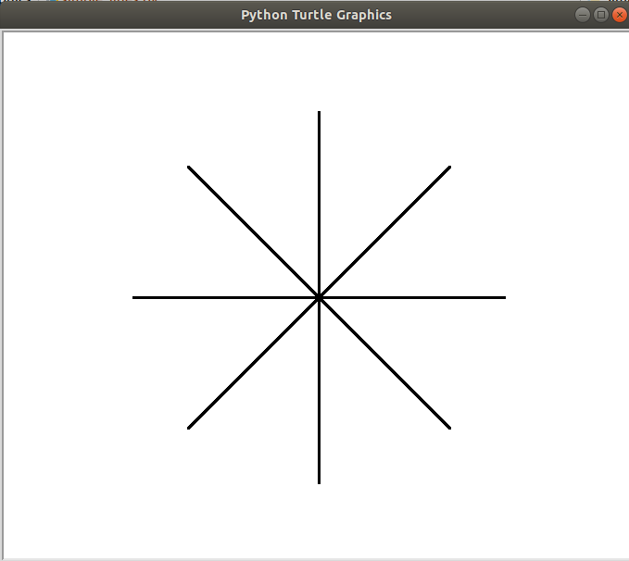

Slide 81
Demo Party Lights
$ python party_lights.py

Slide 82
Solution
https://github.com/purcellconsult/Code-Cool-Stuff-With-Python/blob/master/sourcecode/ch_04/party_lights.py

Slide 83
Show mike and ike demo
$ python mike_and_ike_candies

Slide 84
View the source code
https://github.com/purcellconsult/Code-Cool-Stuff-With-Python/blob/master/sourcecode/ch_04/mike_and_ike_candies.py

Slide 85
One Last Thing to Do With Turtle!
Let’s create a simple racing game.

Slide 86
Let’s Call The Game 4 Little Turtles
a) Create a game that consists of 4 little turtles with unique colors.
b) Include a countdown that starts the game.
c) Create a graphical finish line with the text “Finish Line” directly above it.
d) Randomly generate the speed of the turtles.
e) Write an algorithm to accurately determine which turtle crossed the finish line first.
f) Write a message to let the user know which turtle won.
g) Write a simple algorithm to make the winning turtle spin and then grow in size afterwards.
h) Have fun playing and showing the game off to your friends and family!

Slide 87
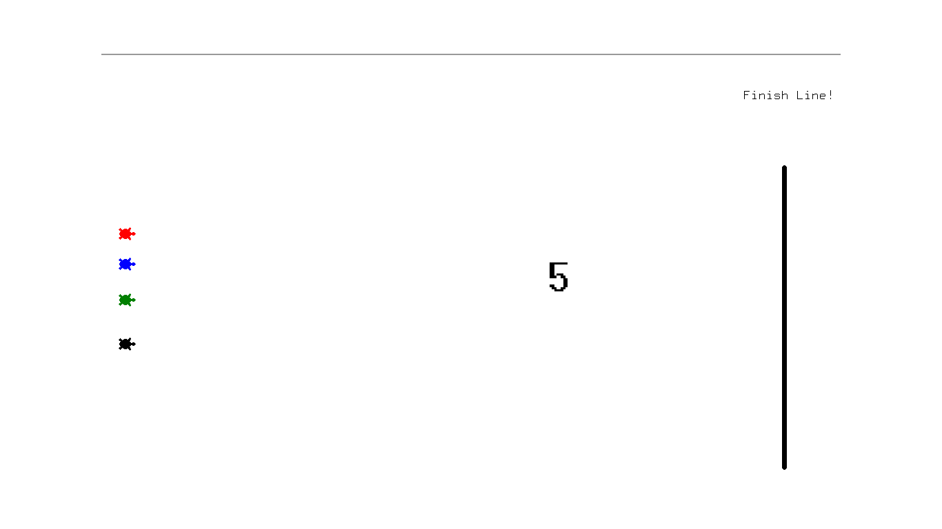
Screenshot 1

Slide 88
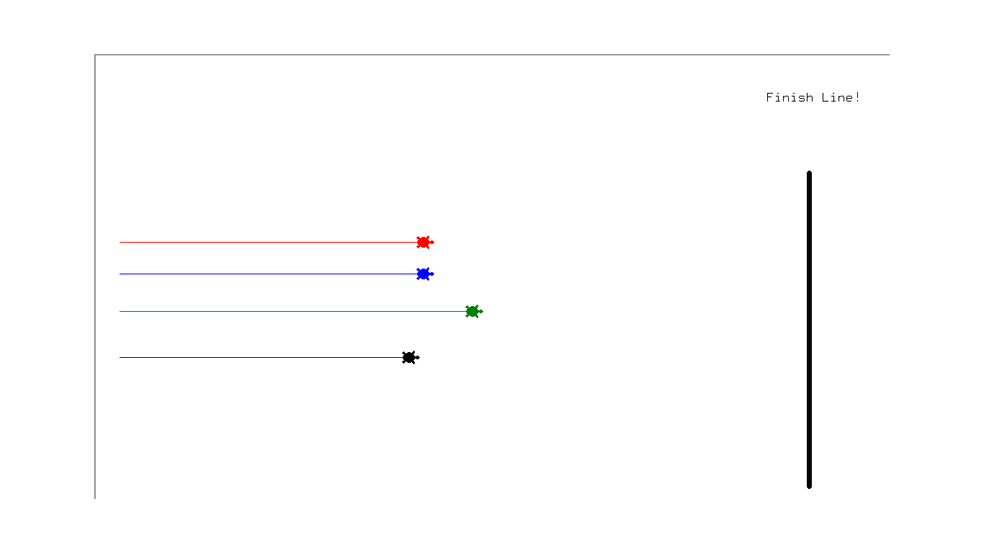
Screenshot 2

Slide 89
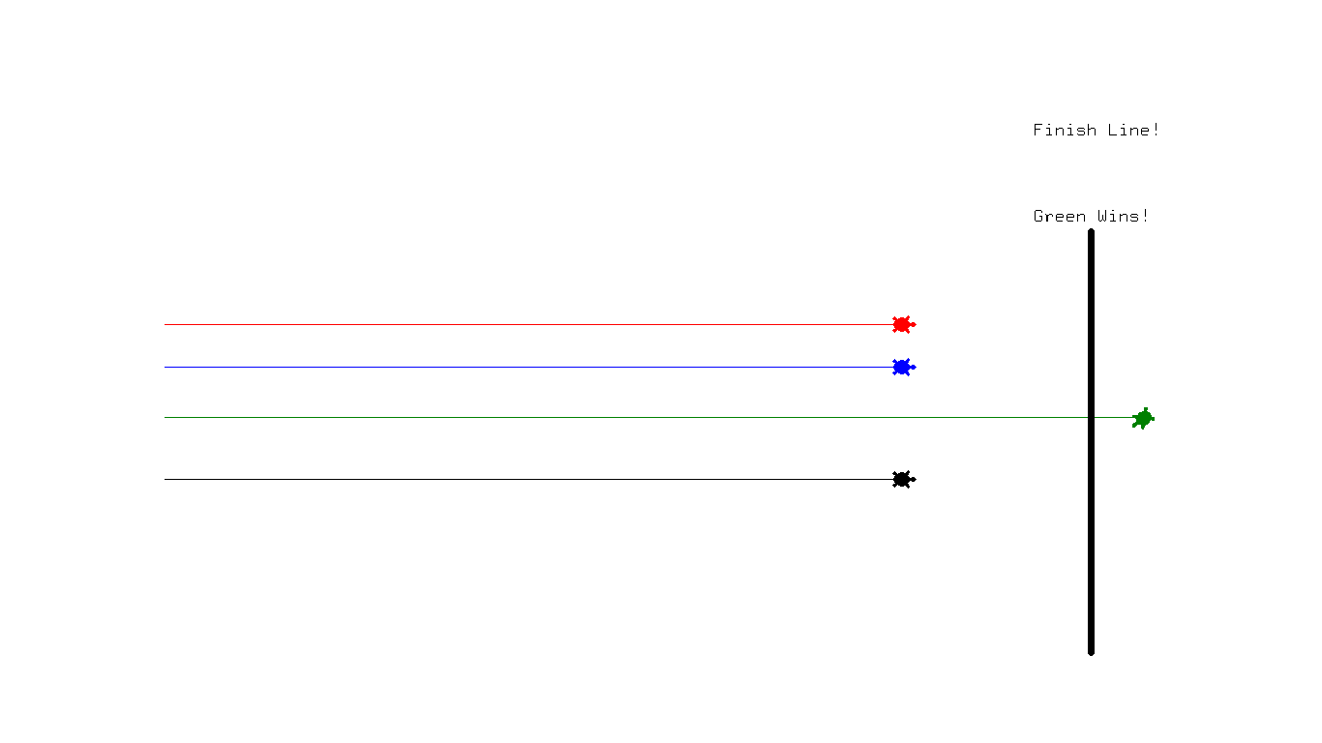
Screenshot 3

Slide 90
Let’s View The Demo
>>> python turtle_racing_game.py
Can anyone guess the winner?

Slide 91
Let’s Define Our Functions
__init__: The constructor which creates the four turtle objects along with getting the height and width of the screen.
start_turtles: Sets the default positions of the turtles.
finish_line: Draws the finish line in the racing game and aligns it on the right hand portion of the screen.
countdown_timer: Starts the countdown timer for the script starting at 5. Use the sleep function from the time module to pause the program.
set_turtle_speeds: Randomly sets the speed of the turtles within the range of 1-25.

Slide 92
Study The Full Source Code
https://github.com/purcellconsult/Code-Cool-Stuff-With-Python/blob/master/sourcecode/ch_04/turtle_racing_game.py

Slide 93
The End :-)

